Slide 1

HTML and JavaScript
The What, How and Why
Ahmad Igbariya
Senior web developer

Slide 2
Agenda
Why should I care
HTML
CSS
JavaScript
Answering “JavaScript is no good”
Notes:
In the HTML/CSS/JS we’ll build the calculator app of the mac OS
Why should I care – 8 min
HTML – 12 min
CSS – 10 min
JavaScript - 18
Answering “JavaScript is no good” – 12 min

Slide 3








Why should I care
Believe me it’s worth it
Easy to begin and learn
Interesting
Vast community support
Promising future with a lot of jobs
Great and fun developing tools
Choose your best suiting programming style
Build amazing looking apps for all platforms

Slide 4
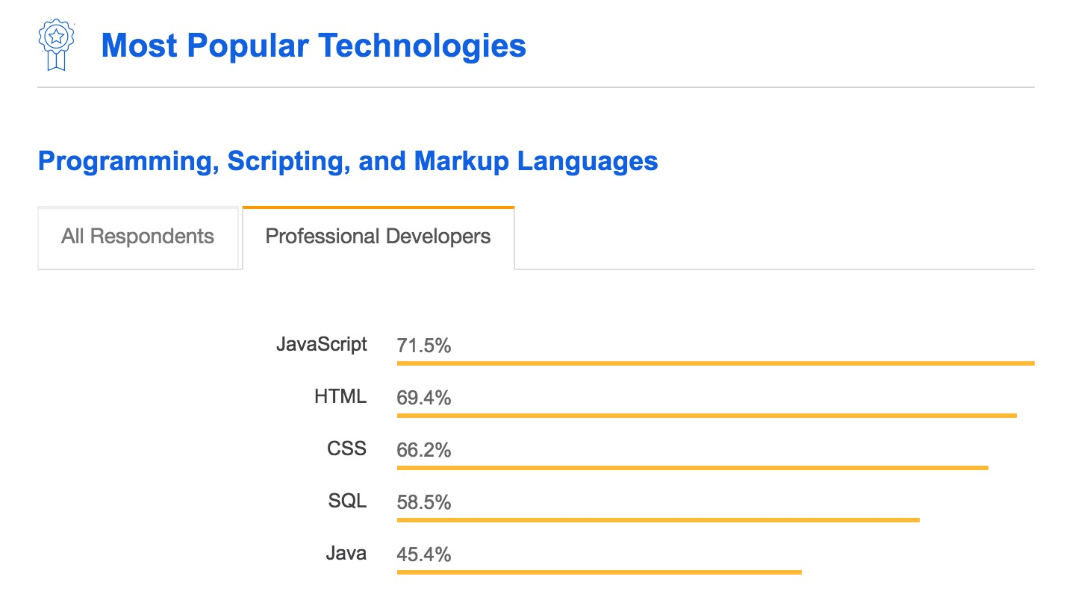
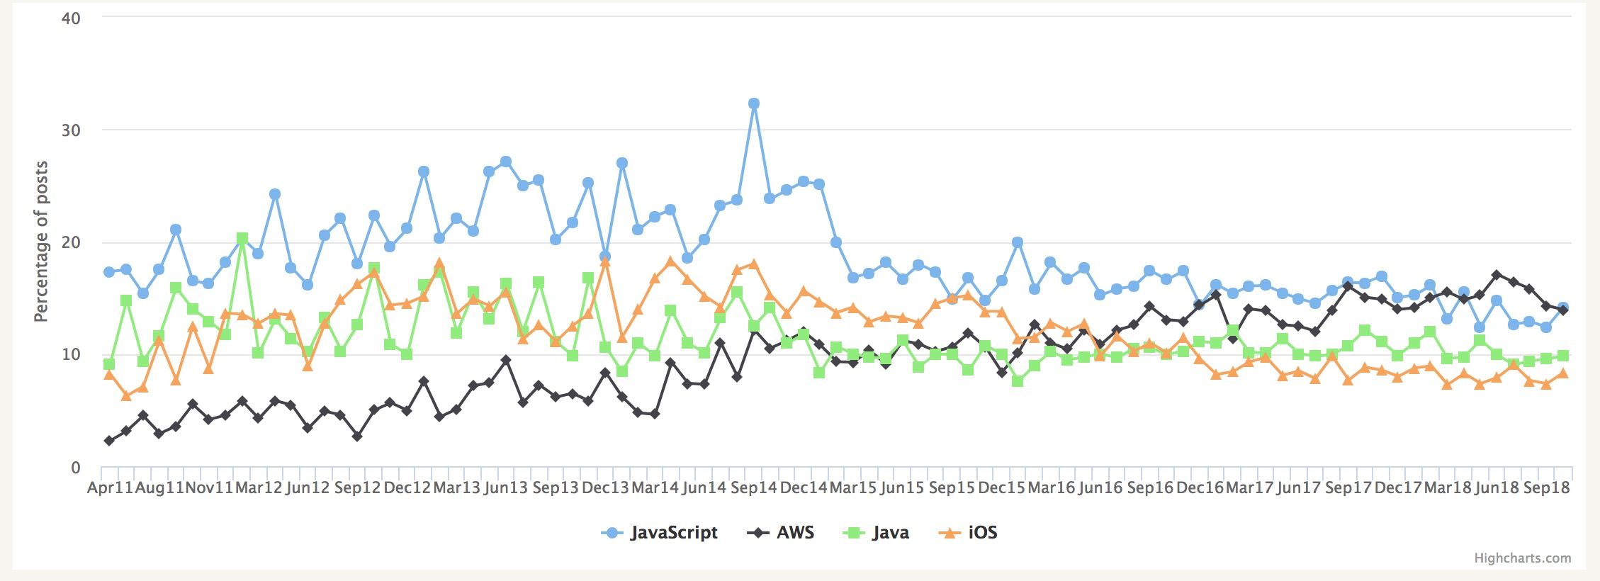
Why should I care
Believe me it’s worth it
“For the sixth year in a row, JavaScript is
the most commonly used programming language.”
“Node.js and AngularJS continue to be the most
commonly used technologies in this category”
Notes:
numbers (open jobs, stackoverflow posts, ...)

Slide 5

HTML
what the heck is it
Notes:
HTML
It’s the standard markup language and the first corner stone of the building web pages along with CSS and Javascript.
As of recent years it’s not used only to build web pages but to build mobile and desktop applications using libraries and frameworks
It’s a cross-platform language (write once run anywhere)

Slide 6
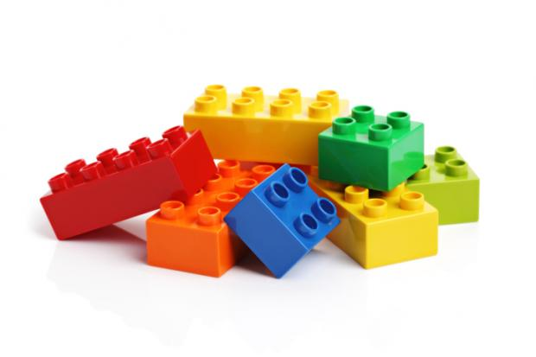
HTML
Hypertext Markup Language
History (1995 – present)
Tim Berners presented an idea in 1989
Standardized and publicly published 1995
HTML5 was published in 2014
Elements
Building blocks of the HTML document
Write once run everywhere
Can write your own (Web Components)
Notes:
History
The idea of the HTML was first presented by Tim Berners-Lee in 1989 and make to be standard and publicly used in Nov 1995
Latest version is HTML5 was published in 2014 and getting updated every year – adding more features to it
Elements
HTML is build out of elements, this of them as the Lego bricks to build your object
You can open them as files in the browsers (no need for servers)
There are online validators to test the correctness of your html code structure (the tricky part is that if you see what you hoped for, doesn’t necessary mean that your code is OK)
Of course there are compatibility issues, look at https://caniuse.com/ for full reference
Can write your own with Web Components

Slide 7
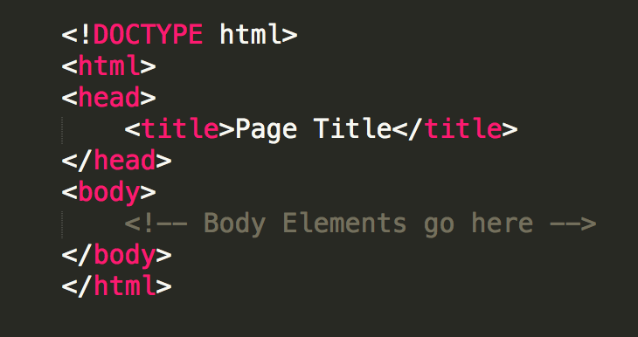
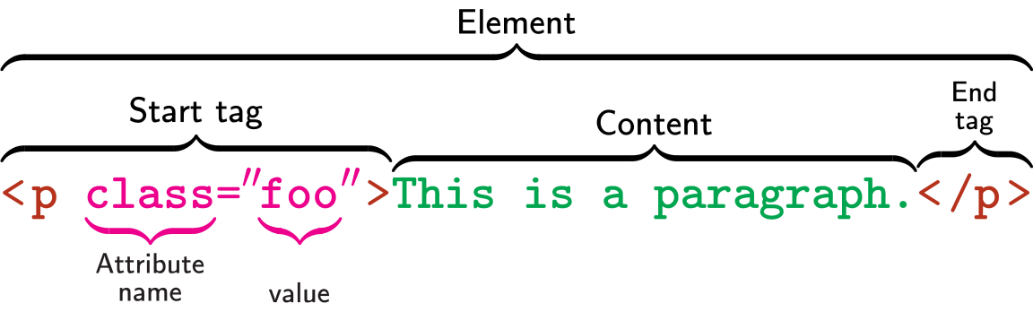
HTML
Hypertext Markup Language (cont.)
Document structure elements
<html>, <head>, <body>
Document head elements
<title>, <meta>, <base> …
Document body elements
Block VS inline
Text
List
Table
Form
Structural elements
HTML Elements (Mozilla)
Notes:
Types of Elements
Document structure elements (html, head, body)
Document head elements (base, link, meta, object, script, style, title)
Document body elements is the most of the HTML elements fall and it can be block or inline elements
Block elements have a rectangular structure, span to the entire parent width
Basic text (p, h1-h8)
Lists (dt, dl, ul, li, …)
Others (address, aside, div, …)
Inline elements are treated as part of the flow of document text; they cannot have margins, width or height set, and do break across lines.
Must be nested inside a block element, can’t be a direct child of body
Elements (a, em, strong, b, I, u, span, …)

Slide 8
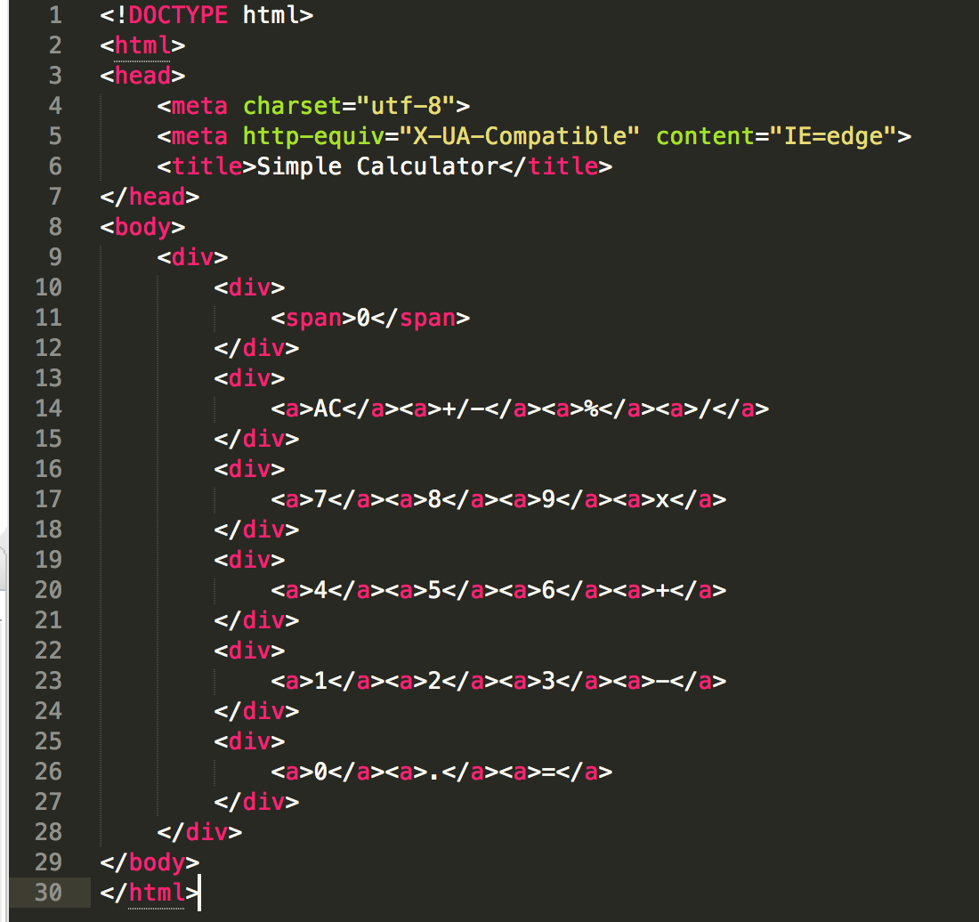
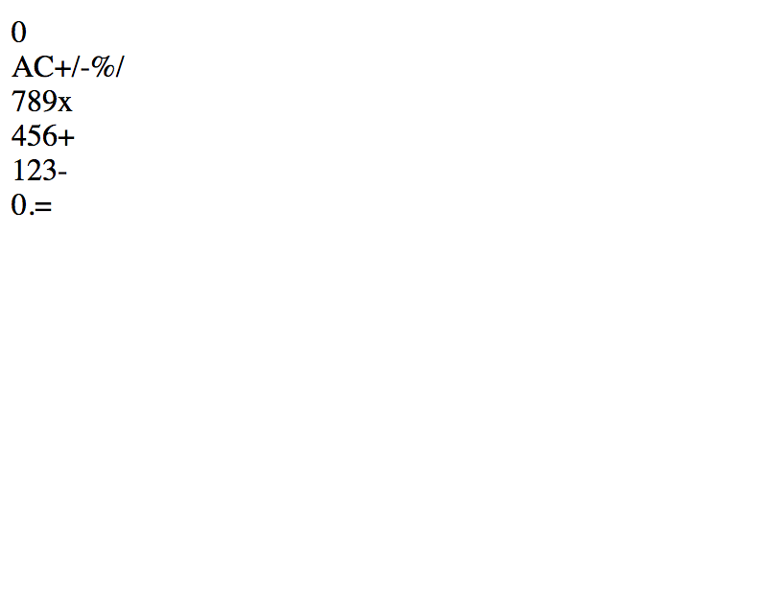
HTML
Example
The HTML source code
The result
Notes:
Exercise: Point out the different types of elements on the document
Show live code + result

Slide 9
CSS
Be cool HTML
😎
Notes:
CSS
It’s the second corner stone of the building web pages.
It’s the presentation layer of the web pages
Has a simple yet powerful syntax, with few limitations
Current version is CSS3, supports so many cool features and layouts
maintained by the W3C with registered MIME type text/css

Slide 10

CSS
Cascade style sheet
1996 The first release
Separated presentation layer
Cascaded
Simple syntax
Advantages
Limitations
Extension languages – LESS, SASS, …
Frameworks – Bootstrap, foundation, …
Notes:
History
Released in 1996 in the version of Bert Bos' proposal
Separated presentation layer
Describes the presentation of the HTML
It’s separated from the HTML content giving us the ability to
Use different presentations for the same content
Improve content accessibility
Share same presentation among other HTML files
Reduce complexity and repetitions
Cascaded - specified priority scheme to determine which style rule applies if more than one rule matches a particular element
Syntax
Selector - declare which part of the markup a style applies to by matching tags and attributes in the markup itself
Attributes and values are defined
Advantages
Separation of content from presentation
Site-wide consistency
Bandwidth
Easy to apply different themes
Limitations
Selectors are unable to ascend
Cannot name rules
Cannot include styles from a rule into another rule only by extension languages
Vertical control limitations

Slide 11
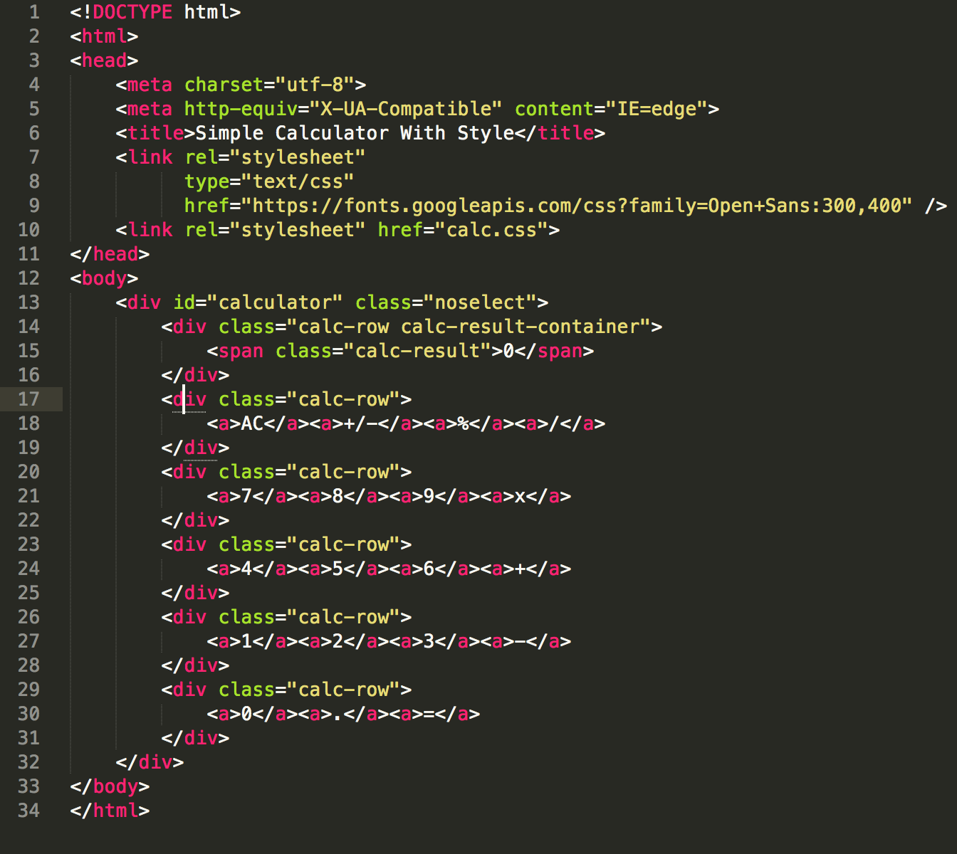
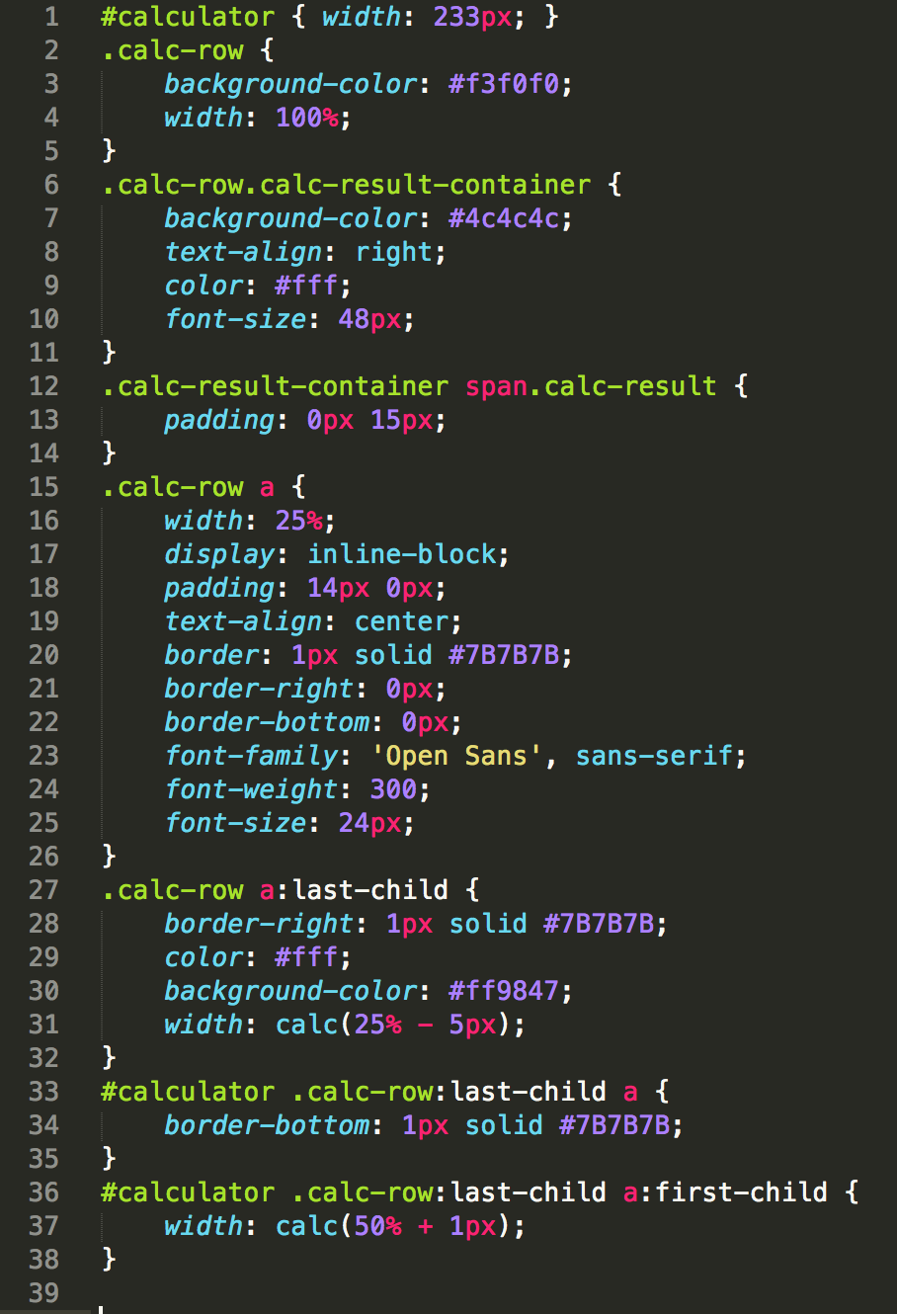
CSS
Example
The HTML source code
The CSS source code
Notes:
Use different sources for CSS and illustrate the priority
Illustrate different selectors: by id, by tag, by attribute, mix, children, …
Live code + result

Slide 12
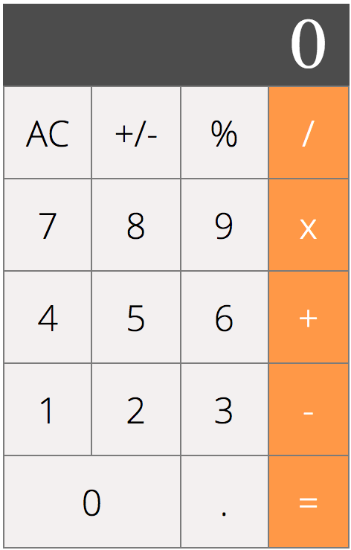
CSS
Example (cont.)
The result

Slide 13
JavaScript
Bring your HTML to life
Notes:
It is the third corner stone technology for the web, it enables interactive web pages, most web sites use it and all web browsers supports it (have a dedicated JS engine)

Slide 14
Notes:
If we said that the HTML describes the web page structure and the CSS gives it colors and presentation, to complete the picture the JS bring the web page to life and interaction with users

Slide 15

JavaScript
The web programming language
History
JavaScript language characteristics
DOM
Code samples
Review parts of the calculator code
Notes:
Describe what we’re going to talk about in the JS section

Slide 16
JavaScript History
Pre-ES
ES1-3 (-4)
ECMAScript 5
ES.Next
1995
Brendan Eich
Developed by Mozilla
Deployed Netscape Navigator 2.0
1997-1999
Versions 1 - 3
Standard specifications
ECMAScript4 was dropped due to political differences
2009 - 2011
Harmony version
Strict mode
Getters/setters
JSON
ES6 - 2015
Yearly releases
ES6 – ES9 today
New syntax
Enrich the language with new features
Notes:
Who created the JS -> Brendan Eich who worked in netscape / sun microsystems
The name JavaScript has nothing to do with Java, maybe they used it for marketing
ECMAScript is the standard for the web scripting languages such as JavaScript. JScript and ActionScript
All versions till ES5 had compatibility issues because browsers vendors implemented as they liked
ES5 and forward, there is some kind of harmony and compatibility
ES next is the term for the next version of the ES, it’s released every year

Slide 17
JavaScript language characteristics
Interpreted
Dynamic
weakly typed
Prototype-base
multi-paradigm
No compiling
Directly executed on the interpreter
Platform independence
Slow
Readable sourcecode
EVAL
Object runtime alteration
Reflection
Macros
Variables can change type
Style of OOP
Objects inherit from objects
No explicit class
Event driven
Functional
Imperative
Prototype
OO
Notes:
JavaScript or JS is a high-level, interpreted programming language that is dynamic, weakly typed, prototype based and has multi-paradigm.
As a multi-paradigm language, JavaScript supports event-driven, functional, and imperative (including object-oriented and prototype-based) programming styles.
It has an API for working with text, arrays, dates, regular expressions, and basic manipulation of the DOM
The language itself does not include any I/O, such as networking, storage, or graphics facilities
Started as a client-side in web browser, but today it’s everywhere (servers, mobile and desktop apps)

Slide 18
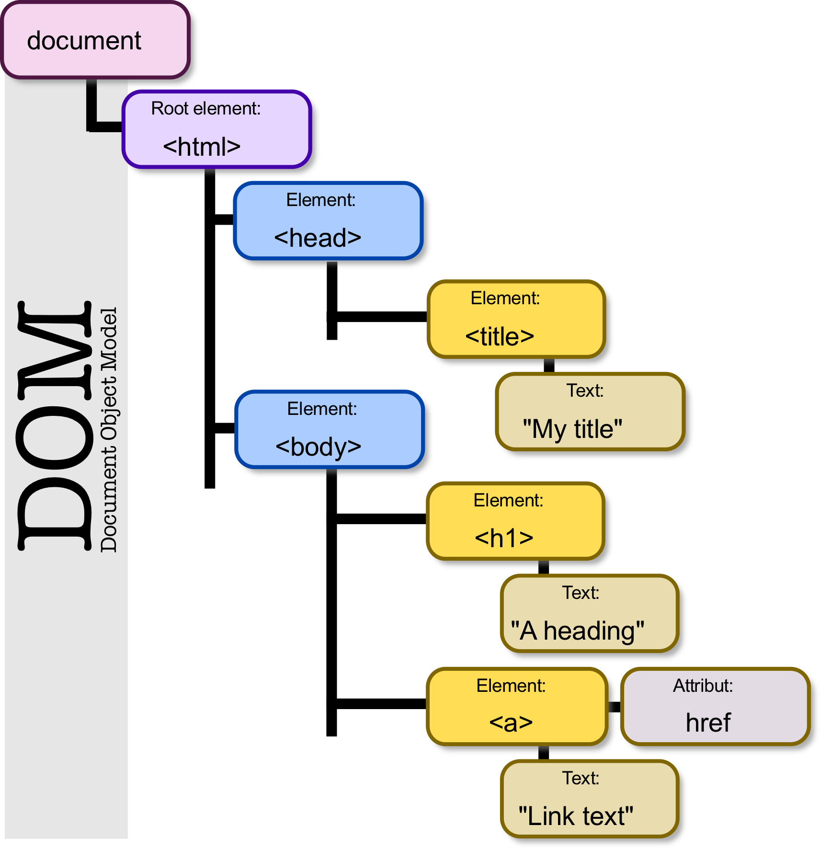
JavaScript - DOM
Document object model
Provided by the browser
Represents the HTML file as a tree
Provide API
Manipulate the HTML elements
Chane the CSS
Work with events

Slide 19
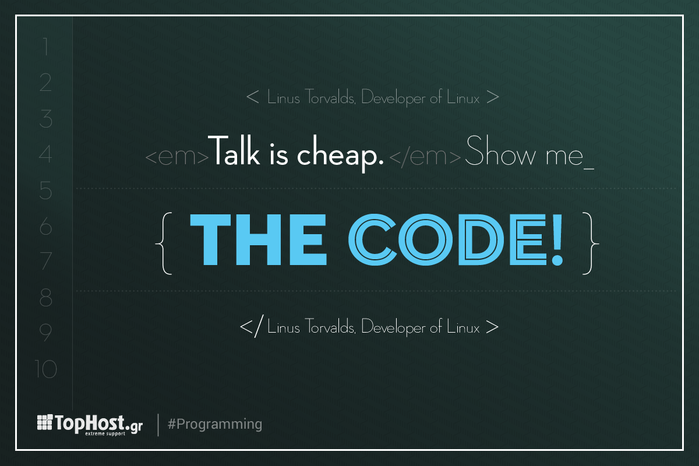
JavaScript

Slide 20
Answering “JavaScript is no good”
Mobile (low computation power)
Robustness (browser compatibilities, JS break whole site is down)
Security (XSS, CSRF)
SEO
Hurt development time (Debugging in production, old browsers compatibility, events)
Testability
Scalability and performance
“Client-side technology is doomed to fail” (java applets, flash, …)
“lacking a lot of core OOP principles” (Difficulty to master for traditional programmers, Code complexity)
Is it really needed? Can’t we do all in server-side?
Notes:
All what is mentioned here are valid points. As any other language, the language itself doesn’t prevent these point from happening, it’s the developer responsibility.
We’ll go and talk about each and every point
Mobile: if the code you wrote is bad, it’ll consume the CPU no matter where. Examples: attaching events, lazy loading, heavy rendering, layers and so.
Robustness:
JS has come a long way, today the browsers almost work the same so the compatibilities issues are reduced.
Breaking code break the whole app, again, it’s the design fault, if you design it correctly at least it will break gracefully
Security (relevant on vanilla JS, most frameworks cover these issues)
CSRF, This is a very important part, because the language is interpreted language it’s easy to manipulate it the secutiry mechanisims should be all the way long, client, service and server
XSS, The solution is easy, just need to make sure to escape any text
Dev time
Debug in prod: Today there are many cool and productive build tools that helps you get the most out of the JS, if you don’t use them, or use them wrongly you will suffer
Old browsers always a bitch, so yes this is a painful point
Events, if you go with events driven paradigm, then you’ll need to know what are you doing because debugging is hell
Testability
Today there are so many tools that help you test such as jest for unit testing and selenium for UI tests
This is relevant to how you choose to code not to the language
Scalability and performance
Using vanilla JS is not scalable nor efficient, if you’re building big projects you’ll need a framework such as react, vue or angular
Build time tools such as webpack make your bundle super light giving you performace advantage
Doomed: JS is the future, it has penetrated every field, today you can build anything using JS/HTML and with todays tools it’s secure and fast
OOP
ES6 solve this issues, and more, it makes coding fun and super fast
Needed
We can’t be extremest, yes it’s needed and no not for every thing, today there is server side rendering

Slide 21
Dive deeper
Do you dare?

Slide 22
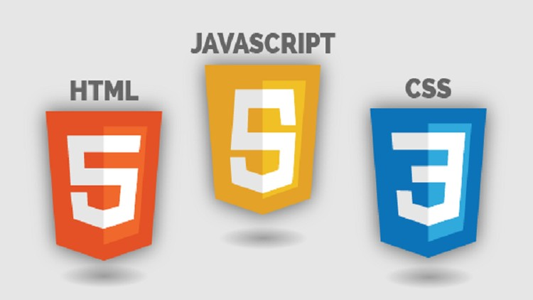
Want to learn more?
Tools and editors
Online IDE: liveweave, codesandbox, …
Offline IDE: Sublime text / ATOM / VSCode
Compatibility checker: https://caniuse.com/
HTML Validator
HTML Elements (Mozilla)
Web Components: Slim.js, Polymer, …
CSS Frameworks
JavaScript handbook
Notes:
Links for Mozilla developer
Link for W3C
Youtube video for deep JS
Links for CSS (frameworks, tools, blogs)
Tools and editors
Online IDE: liveweave, codesandbox, …
Offline IDE: Sublime text / ATOM / VSCode
Compatibility checker: https://caniuse.com/
Web Components: Slim.js, Polymer, …

Slide 23
Questions?
ahmad.igbariya@servicenow.com

Slide 24
Thank you
ahmad.igbariya@servicenow.com
Notes:
Add link github for the presentation and code

